Slide 1

Emotion Tech
・”We want to listen to the voice of customers for improving our business operation, but we have no ideas how to begin.”
・”We don’t have extra human resources for research and data analytics.
・”We want to improve our customer loyalty.”
In response to these problems and issues,
Emotion Tech, with our know-how and skills in IT, human resources, and marketing, provides cloud solutions to our clients.

Slide 2


Most common issues
While understanding customers is important, it is difficult to take the right actions.💦
Missing opportunities, prioritization of issues, efficiency, cost cutting
We do not know what matrix should we use to understand customers.
（Optimal measurement）
We spend too much time and effort for data collection and analysis.
（Heavy workload）
Every time,
we got similar result and there is no new discoveries.
（Bottleneck）
We could identify different issues but failed to prioritize the most important one.
（Prioritization of issues）
We do not know the trend even we read all suggestions/comments from our customers.
（Text analytics）
We failed to response quickly to the survey results.
（Missing opportunities）
Notes:
・数字で、この数字で無駄になっている
・業界でＮＰＳをやっている
・競合他社がやっている、目標にすべき会社がやっている
・これから成長する企業だと、今から、
・今までは、before/after、 やってなかったらずっと○○円のコストだった、売上だった。積算した過去企業
・リスク系焦らす。めっちゃ煽る→批判系のコメントで煽る→○○な事件が、
・パイの取り合いになっている感、業界全体で縮小しているぞ
・顧客がどんどん取られて行っているよ。限られたパイ
・成約率→新規商談パターン before/after
・
・
・クローズドループが出来てなかったから、
◆対面営業 →成約率
“今やらないとヤバイ”
①今、既にヤバイ
今、批判的な人がいっぱいいる
水漏れしまくっている
②今やってないと将来ヤバイ
業界で既にやっている
今やらないと、金額が延々続く
中長期成長が鈍化する

Slide 3
About us
“EmotionTech” for customer experience management &
“EmployeeTech” for employee experience management
Company name | Emotion Tech Inc.（株式会社Emotion Tech）
CEO | Imanishi Yoshimitsu
Address | Office: Floor 4, Nagatacho GRID Hirakawacho 2-5-3, Tokyo Research Center: Waseda University Research Innovation Center Business Incubation Division
Date of establishment | 8th March, 2013
資本金 | 602 million yen (including capital reserve)
Business | Support clients’ customer management initiative with our in-house developed cloud system “EmotionTech”. Similarly, support clients’ employee engagement program with our in-house developed cloud system “EmployeeTech”.
Patent right | Patent No. 6176813 Computer system for analyzing users’ rating on a subject and the method for using the system

Slide 4














What is the customer loyalty benchmark “NPS®”?
“NPS® is a popular index in customer experience management
Net Promoter Score(ネット・プロモーター・スコア)
It is an index that quantifies customer loyalty (feeling of attachment, the degree of trust)
“How likely is it that you would recommend [brand] to a friend or colleague?”
0
1
2
3
4
5
6
7
8
9
10
NPS®
Promoters
Passively satisfied
４０％
２５％
１５％
NPS® has been applied by more than one-third of the top US sales companies. (Fortune 500)
※ ネット・プロモーター® 、ネット・プロモーター・システム® 、ネット・プロモーター・スコア®及び、NPS®は、
ベイン・アンド・カンパニー、フレッド・ライクヘルド、サトメトリックス・システムズの登録商標です。

Slide 5



明確に異なる行動パターン・態度をとる顧客グループです
According to the degree of recommendation, customers are divided into three groups.
Detractors (score 0-6), Passives (score 7-8), and Promoters (score 9-10)
Increasing promoters (=fans) is critical.
Promoters
score
9-10
“Highest repurchase rate” “Purchase of various products”
“Good word-of-month” “Low price sensitivity”
The number of promoters grows with the popularity of a brand.
Over 80% of referral were recommended by customers in this category.
Passives
Score
7-8
“I’m not a fan, but I’m not against it.”
“I will choose a different brand if there is a promotion campaign.” “Potential to become promoters”
Repurchase rate and referral rate in this category are 50% lower than the rates in Promoters category.
People in this category purchase by inertia rather than by loyalty to specific brand.
Detractors
Score
0-6
“Low purchase amount and value”
“80% negative review”
“High tendency to switch to competitors’ products/services”
The negative attitude and comments not only hurt the company reputation, dampening new customers’ willingness to purchase the company’s products/services, but also affect employee morale.

Slide 6
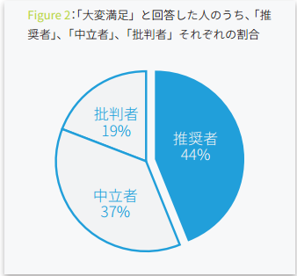
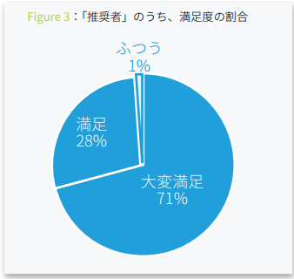
Why NPS® is a good metric①
NPS® is better than customer satisfaction index.
It is simple, easy to be understood.
It has high correlation with revenue.
Majority of respondents select “satisfied” or “highly satisfied”. Extremely hard to distract useful information.
Satisfied customers do not necessary spread a good word-of-mouth.
In other words, simply increasing the no. of satisfaction does not lead to an increase in customers
Detract-ors
19%
Promoters
44%
Satisfied
28%
Passives
37%
Highly satisfied
71%
＜Differences between NPS and traditional CS scale＞
Through NPS® (How likely is it that you would recommend?), we can quantify the expected future actions and forecast the followed-by profitability by those quantified data.
Traditional CS scale (Are you satisfied?), focus on current situation. Using that scale, we can quantify current actions/ situation, while it is unlikely that the qualified data would have strong relationship with future profitability.

Slide 7





Why NPS® is a good metric②
NPS® is an indicator of your customers’ actions. It is driver of your profit.
Links with many important KPI
Churn rate, Number of transactions, Average order size, Product affinity, No. of positive word-of-mouth etc.
Sales
PROFIT UP
When loyalty goes up
EC, WEB services
Purchase frequency
Average order value (AOV)
Repeat purchase rate
No. of good product review
Cross-sell, etc.
Retail, mass merchandise service
Purchase frequency
Average order value
Conversion rate
Repeat purchase rate
Point card possession rate, etc.
Goods and services
Higher preference among competitors
Repeat purchase rate
No. of good product review, non-sale purchase rate, etc.
COST
Customers’
Loyalty and attachment
Increase in loyalty helps you to reduce
Membership turnover rate
Customer acquisition cost (CAC)
Advertising cost
Customer service phone call count
No. of bad product review, etc.
“How likely is it that you would recommend
This brand/ product to your friend or colleague?”
※Based on clients’ feedbacks and various analysis of clients’ data

Slide 8
Why NPS® is a good metric③
NPS®と is related to the profitability of your business.
The higher the NPS®, the higher growth rate
The higher the NPS®, the higher the number of long-term customers. (>1 year)
Automotive industry in Japan
Mercedes-Benz
Number of long-term customers. (>1 year)
Healthy food industry
DHC
FANCL
Growth rate
Wakasa Seikatsu Corporation
Audi
BMW
Yamada Bee Farm
Yazuya
Honda
Subaru
Suzuki
Mazda
Toyota
Setagaya Shizensyokuhin Co.
Suntory-kenko
Daihatsu
Volkswagen
Nissan
Asahi-ryokuken
三菱
R=0.82
R=0.68
NPS
NPS
Reference：日経BPコンサルティングとEmotion Tech 自動車業界の「NPS×カスタマージャーニー」について共同調査を実施
2017/11/21 リリース
Reference：エイジアとEmotion Tech 健康食品通販大手のECサイトにおける顧客ロイヤルティ調査を実施
2018/3/29 日本流通産業新聞掲載

Slide 9
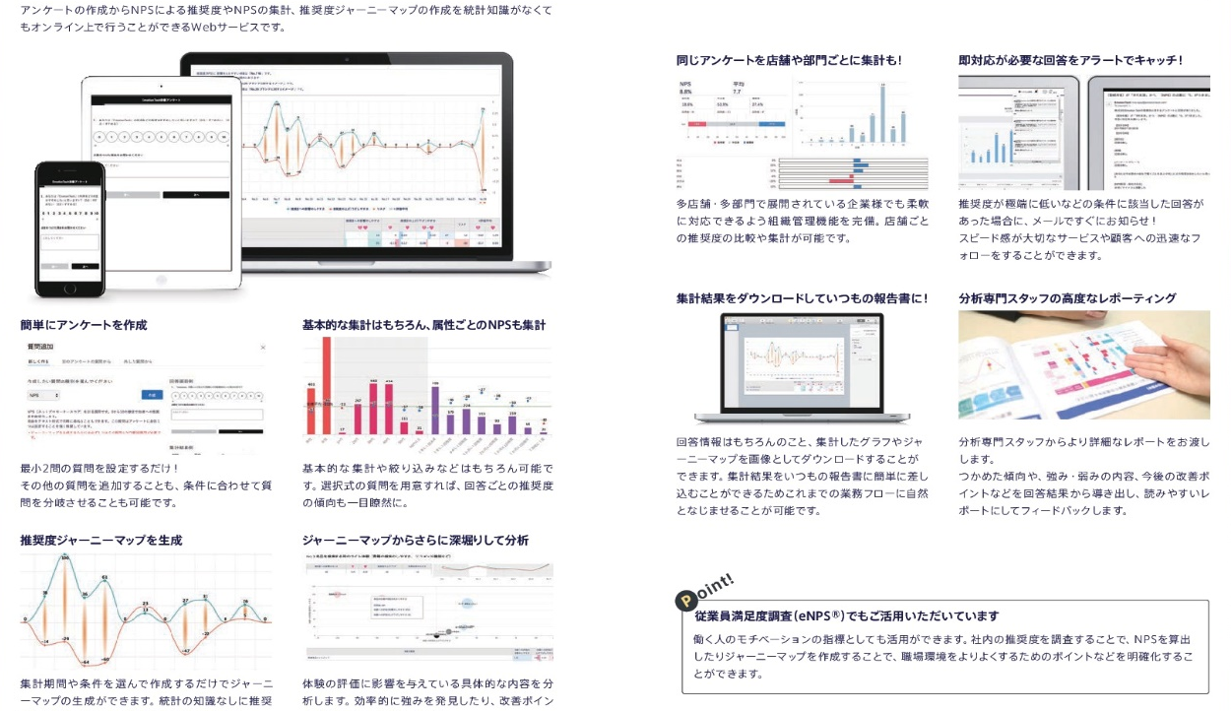
Our strengths
A system can help you easily handle high-level “customer experience management”
Knowledge on NPS® and data analysis technology
“Emotion Tech”, the platform for customer experience management
Knowledge on applying NPS®
Supporting top-tier Japanese company
Effective use of NPS® know-how
Functions that enable
Easy and high-level
“Customer experience management”
Data analysis technology
Possessing a patent for survey design, data analysis, data visualization in improving customer experience
※Patent no. 6176813

Slide 10























ご支援先
Supporting more than 300 companies
in customer experience management (CXM) for increasing profit
◆Membership-based business
Want to increase member retention,
Want to prevent membership outflow to competitors,
Want to maximize the no. of high-end members.
◆High-end, face-to-face customer service essential business
Want to improve the “quality of negotiation”
Want to maximize the “successful rate”
◆Service companies that provide value based on “people”
Want to improve the performance of our staff, which is the customer contact point
Want to improve employee loyalty

Slide 11

Case study①：Yakult Swallows
We want to make a move that is effective in increasing the number of new members, the retention rate, and the membership type. Also, there is a problem that customers' opinions are not utilized.
The number of paid subscribers have increased by 4.5 times in two years.
36%↑
NPS®/2 years
115%↑
Growth rate
4.5 Times↑
Paid subscribers/2 years
・By asking the subscribers “How likely is it that you would recommend Yakult Swallows to a friend or a colleague?”, they told the fan club what they really felt.
・By analyzing the loyal scale (NPS®), we are enable to select specific actions, which have strong correlation with the scale, to improve the number of paid subscribers.

Slide 12
Case study②：Full Speed
We have no ideas how to improve the sales skills of sales representatives so that the revenue increases.
We do not know the strengths or weakness of each department.
１年間で顧客単価を32%UP
Issues
After implementing Emotion Tech
32%↑
Average order value
Unable to change sales behavior
Identify key touch point affecting NPS®
Do not have specific guideline for taking actions
Apply specific guideline for taking actions in each department
6%↑
NPS®/1 year
Failed to run the PDCA in a short period of time
Monitor the effectiveness of actions periodically

Slide 13





After all, what is “Customer experience management”?
Improve customer loyalty(NPS®) for revenue
To find a “customer experience” that needs to be enhanced and improved
To find “specific action” that influence the quality of customer experience
“Profits” and
“Customer behaviors”
Emotional indicator behind “Profits” and “Customer behaviors”
Customer experience (CX)
Specific elements of customer experience
Life time value
（≒LTV）
Loyalty
（NPS level）
CX①
Specific element A
+xxxdollars
Specific element B
Frequency
+xxtimes
CX②
Specific element C
Monetary
Specific element D
+xxxdollars
CX③
Specific element E
Recency
-xxxDay
Specific element F
CX④
Specific element G
No. of referrals, etc.
xxx
Specific element H
…
…

Slide 14
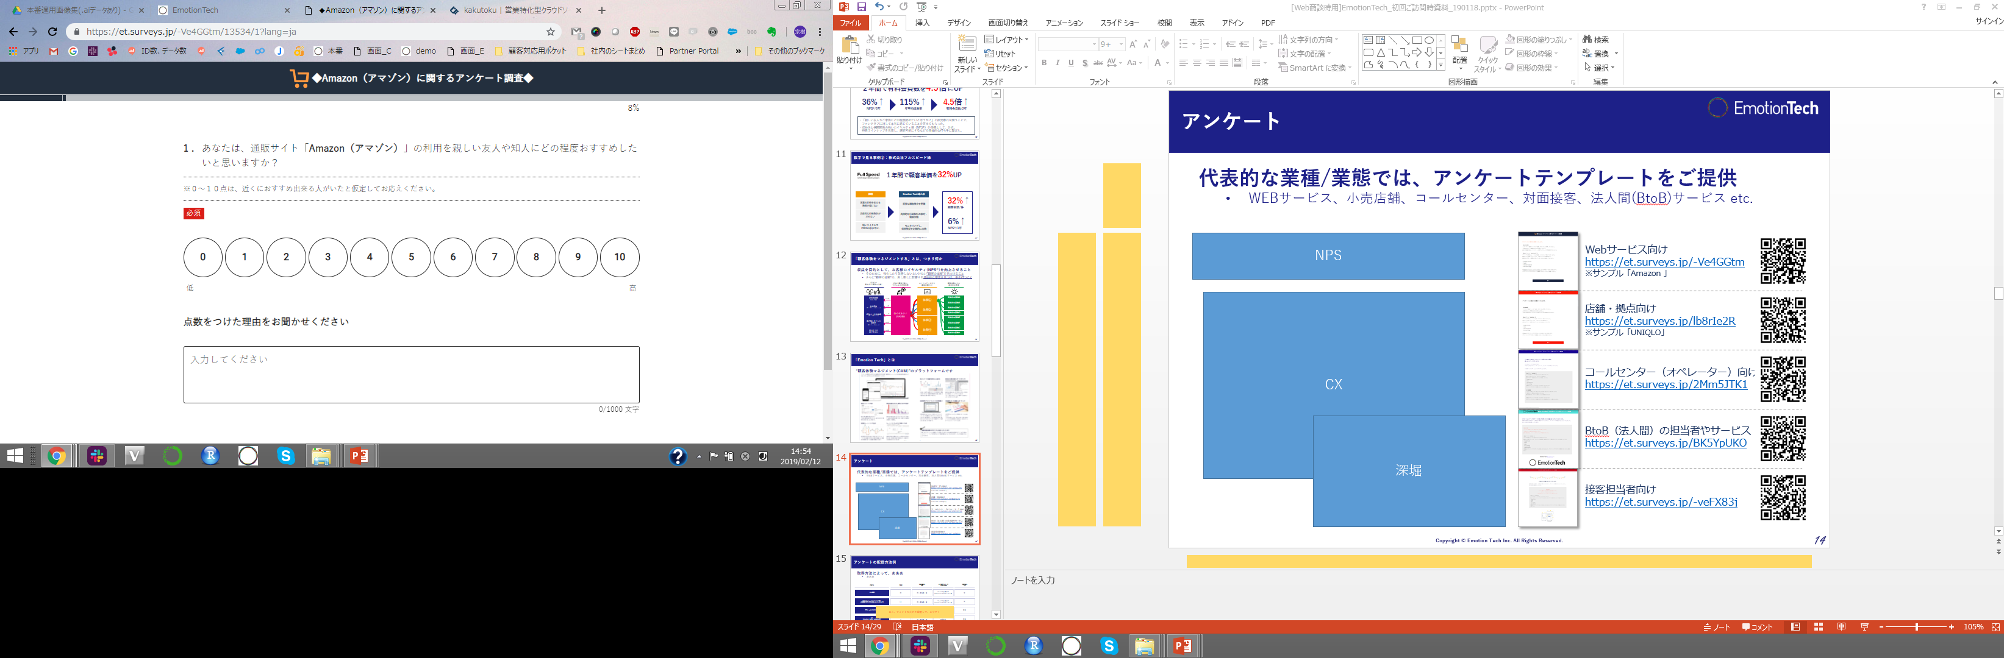

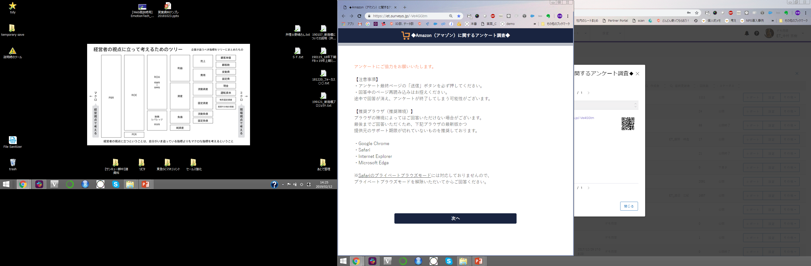
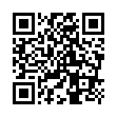
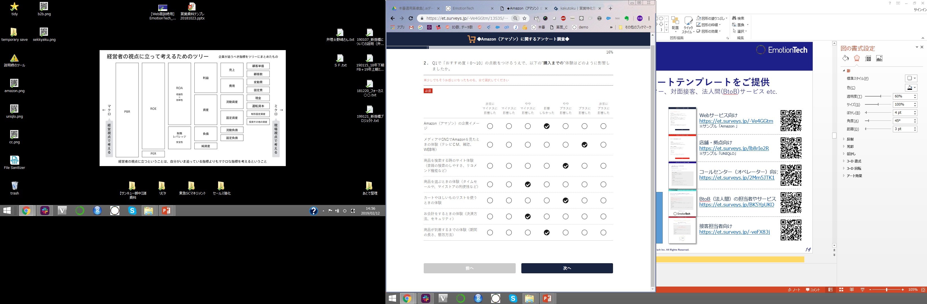
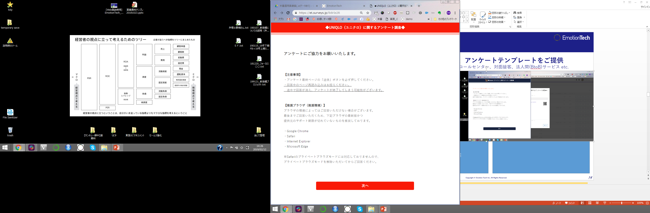
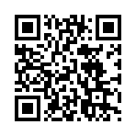

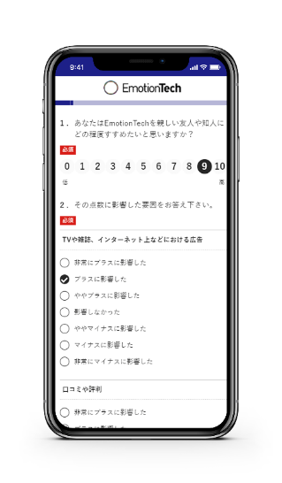
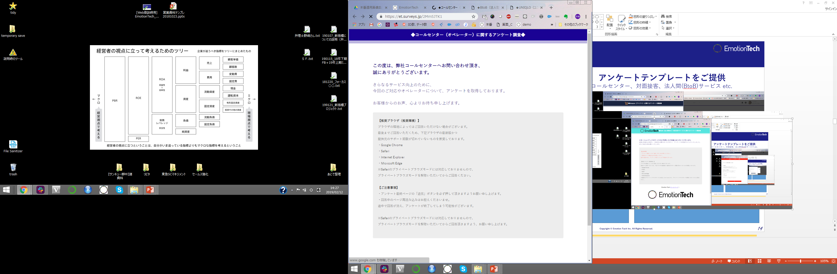
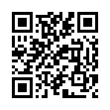
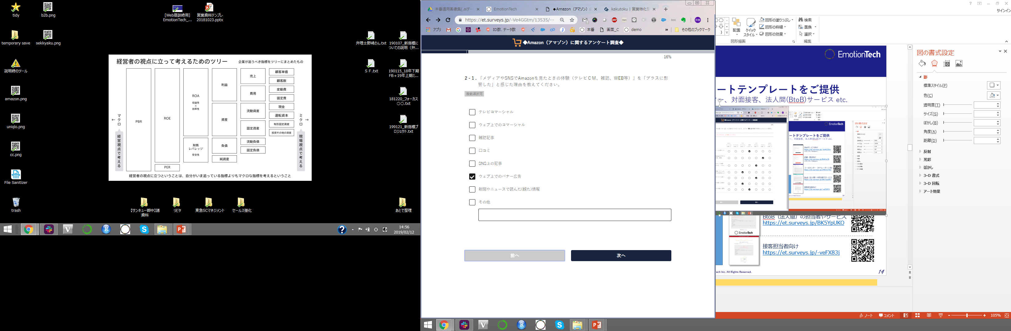
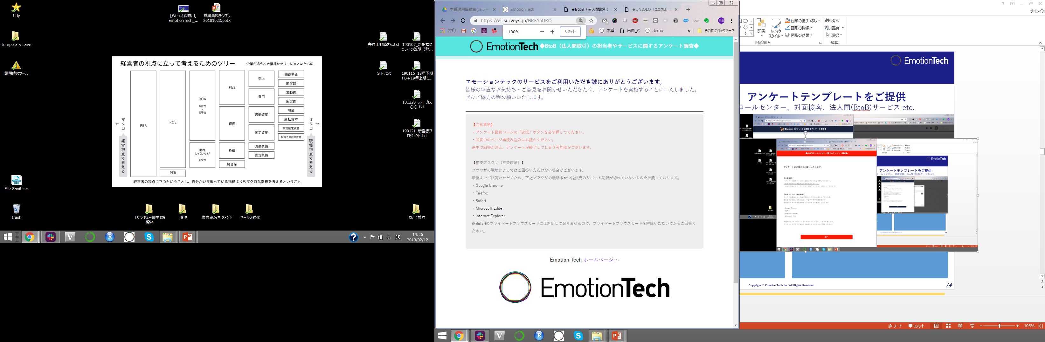
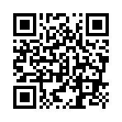
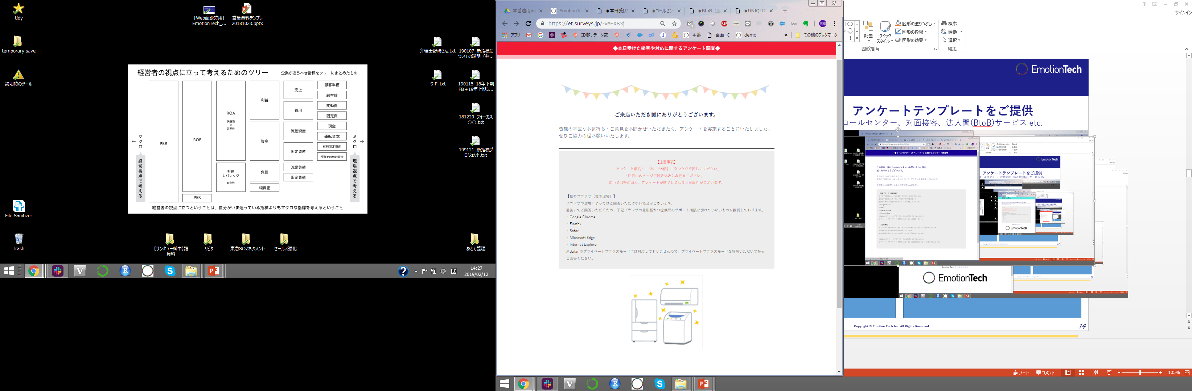
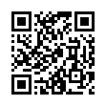
Easy-to-answer screen design
Easy-to-answer designed screen and survey template are provided
WEB service, retail, call center, face-to-face business, B-to-B business, etc.
Use template to speed up implementation
Template for Web service
https://et.surveys.jp/-Ve4GGtm
※サンプル「Amazon」
Template for retail
https://et.surveys.jp/lb8rIe2R
※サンプル「UNIQLO」
Template for call center
https://et.surveys.jp/2Mm5JTK1
Template for B-to-B business
https://et.surveys.jp/BK5YpUKO
Template for customer service
https://et.surveys.jp/-veFX83j

Slide 15
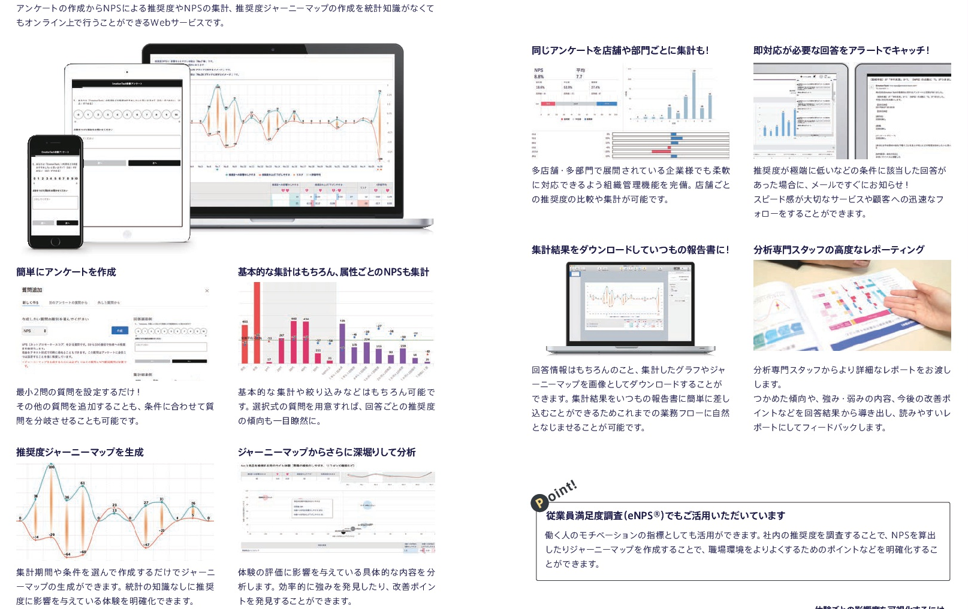
About “Emotion Tech”
See the details in attachments
A platform for “Customer Experience Management (CXM)”

Slide 16
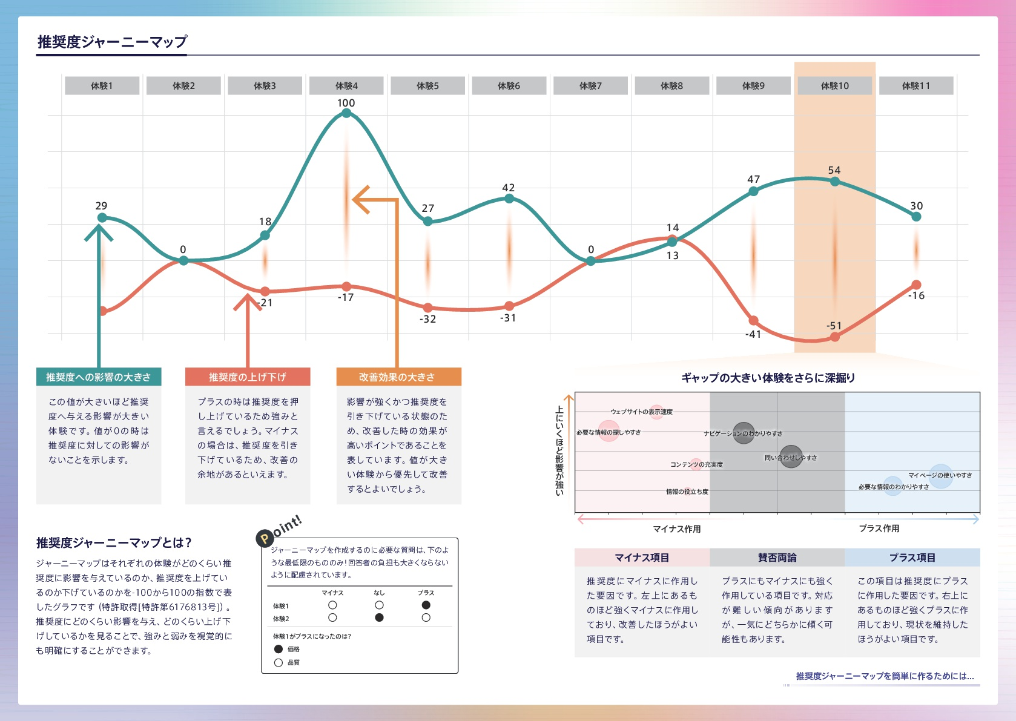
About “Emotion Tech”
See the details in attachments
A platform for “Customer Experience Management (CXM)”

Slide 17
Survey distribution methods
Extensive know-how on acquiring survey answers are provided
Different methods for different respondents
Our customer success representative will give you recommendation about this issue
Methods |  | Response rate |  | Difficulty in data collection |  | Examples ※Respondents |  | Specific distribution to certain individuals Can/cannot
Email |  | ◎ |  | ◎：Low |  | Service members & Web service users |  | Can
SMS （Short message service） ※Mobile |  | ○ |  | ◎：Low |  | Service members & Web service users |  | Can
Banner posed in application/web |  | ○ |  | ◎：Low |  | Unspecified web users |  | Difficult
SNS ※Facebook、twitter、instagram |  | △ |  | ◎：Low |  | Unspecified web users |  | Difficult
QR receipt/ Card distribution |  | ◎ |  | ○：Medium |  | Unspecified store visitors |  | Possible E.g. receipt no.
Traditional paper |  | △ |  | ✕：High |  | Unspecified store visitors |  | Difficult

Slide 18
Pricing
The package combining the basic functions you can use at a “minimum required” rate
The minimum required rate is 50,000 yen per month
（Exclude tax）
 | Amount | Cover
Initial installation charge | 300,000 yen ※For the first time only | ・Survey template*¹ ・System manual ・How to use the system*² ・Basic settings(User/ organization setting) ・Survey implementation agency (For the first time only)
 | Amount | Functions
System usage fee | 50,000 yen～/month ※Maximum user ID：5 ※Please contact us if you wish to use more than 6 IDs | ・Survey creation ・Aggregation ・NPS display by attribute ・Data download ・Alert mail ・Segment
 | Amount | Function
Optional | Details on the next page | ・Details on the next page
●最低ご契約期間は12ヶ月(1年間)です（ご契約期間中の途中解約はできません）。 ●アンケートの作成数に上限はございません。 ●収益関係性分析レポートをご希望に応じて作成いたします*³ 。 ●レポートの資料化をご希望の場合は別途費用が発生いたします(都度お見積もり)。 ●従業員ロイヤルティ調査とセットで行う場合、初期導入費(20万円)が追加で発生します
*¹ご契約期間中の質問設計については、初回に限らず当社担当者が伴走支援いたします
*²貴社ご担当者様にシステムを触っていただきながらの、ハンズオン形式となります
*³ご契約期間内において1本までは無償。2本目以降は有償となります

Slide 19
List of optional functions
Many additional functions are available
The person in charge will guide you to the most suitable plan
(All prices are monthly-based and excluded tax)
Function | Amount* | Description
Journey map/ Factors analysis | 50,000 yen | ・Analyze the issues to be improved ・An essential function for companies who consider a full-scale CXM
Survey group | 30,000 yen | ・An essential function for companies with multiple stores ・Adding or deleting any store would not change the survey URL or question
Sub domain | 5,000 yen | ・Customizing the URL for your own company
Management screen IP restrictions | 10,000 yen | ・Allowing access to the management screen from a specific IP
Data combination | 20,000 yen | ・Using the identification ID function, your company data can be linked with the system. ・Various tabulation and analysis are possible with the linked data
●機能の追加をご希望の際は、担当者にご連絡くださいませ。●ご契約中の機能追加もしていただけます（ただし、ご契約期間中に追加した機能は、次回ご契約更新時まで途中解約はできません。）

Slide 20
Recommended plan
Running fee starts at 50,000
During the contract period, you can add any additional functions you required.
 | Light plan | Recommended plan | Multiple stores trial plan
 | For those who want to listen to the voice of customers in real time | For those who want to have an authentic CXM | For those who consider introducing the system into stores
Monthly total | 50,000 yen/month | 100,000 yen/month | 185,000 yen/month
System usage fee | 50,000 yen/month ※Maximum user ID：5 | 50,000 yen/month ※Maximum user ID：5 | 100,000 yen/month ※Maximum user ID：10
Optional | - | ■Journey map/ factor analysis 50,000 yen/month | ■Journey map/ factor analysis 50,000 yen/month ■Survey group 30,000 yen/month ■Sub domain 5,000 yen/month
●別途初期導入費が発生いたします。●金額はすべて月額単価および税別です。●ご契約期間中の途中解約はできません。●ID数および機能の追加をご検討いただく場合、担当者にご連絡くださいませ

Slide 21
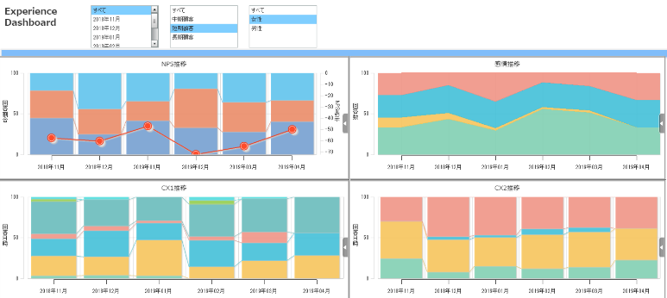
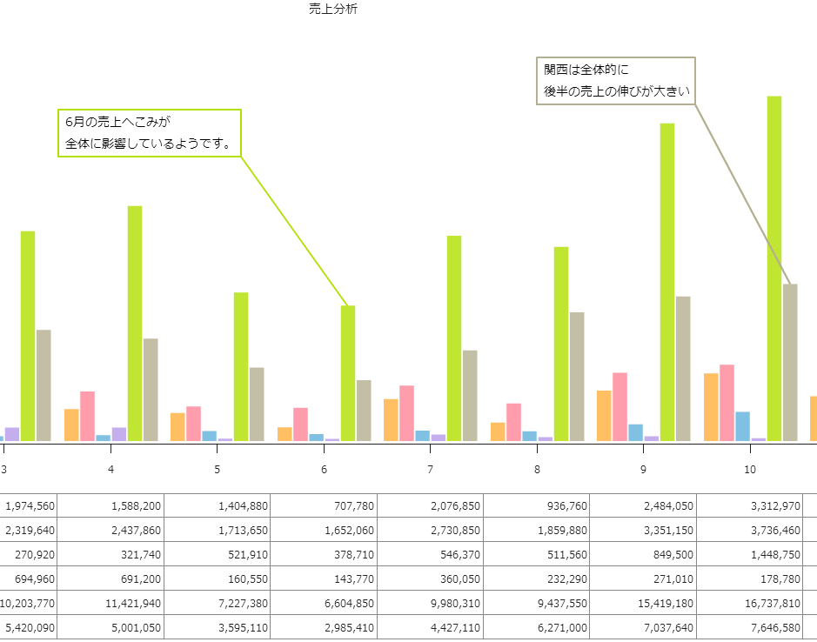


Cooperation with external services
Cooperation with other service providers for more advanced usage
①Create report for each store so that site staffing can read the report any time
②Find out the strengths and weaknesses in comparison with other competitors
①Create your own dashboard
“Motion Board” from Wing Ark 1st
Aggregate different dashboards from multiple sources
Able to monitor important changes, for instance, “NPS” and “sales”, at the same time without assessing to multiple systems
②Cooperation with Internet research
“JAPAN Cloud Panel” from GMO Research’s
Your survey can be sent to 16.2 million members in the Panel through our system
Able to analyze the strengths and weaknesses of your competitors
●ご活用範囲に応じて、別途お見積り差し上げます

Slide 22
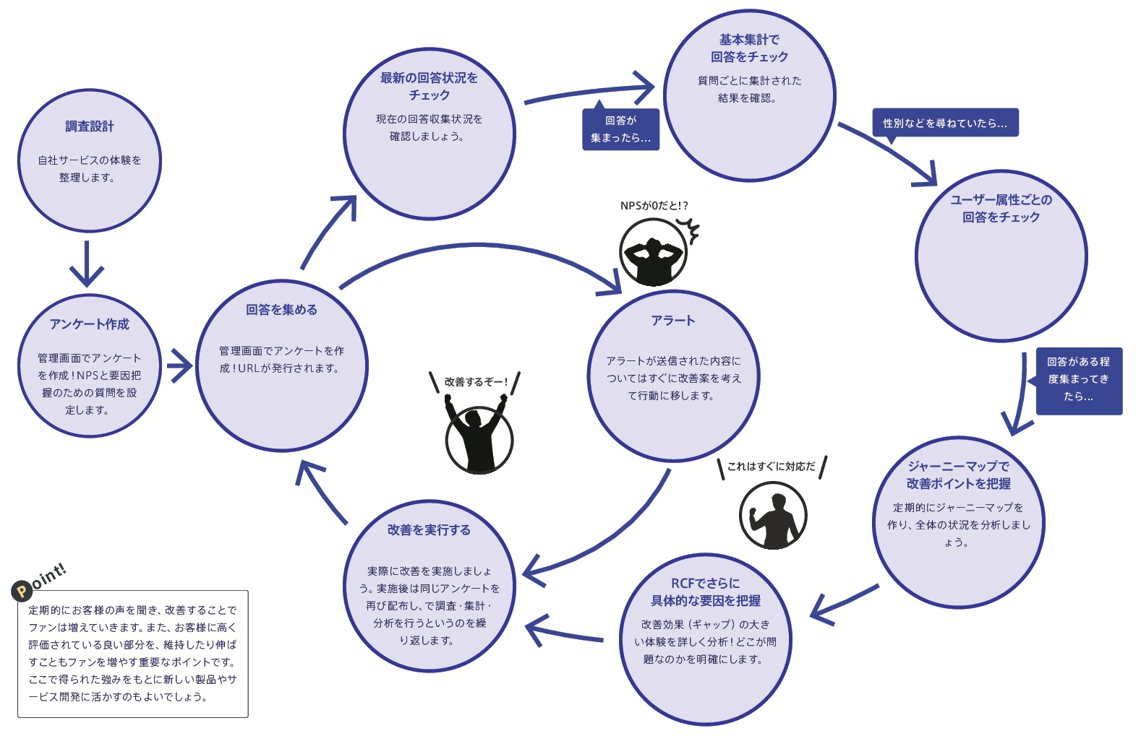




After your application
At the beginning, we will conduct an interview for survey design
During this period, a customer success representative will help you to achieve the best design.
Check the response as a whole
Follow the latest response
Lecture about how to use the system
Design survey
Once all the answers are collected..
If you are interested in response from different gender
If NPS is 0?
Check the response from different attributes
Confirmation from your company
Create survey in the system
Collect responses
Plan the action based on alert
Submission of survey template
Submission of schedule
The mode to improve
After you have some ideas…
Support from our representative
Apply the insights from the response for your journey map
Kick off
Purpose/objectives
Schedule
The flow of customer experience, etc.
It’s like a match
Take action to improve
お申込み
Use RCF to identify more specific factors
Application
Survey improvement support

Slide 23
FAQs
How many responses do we have to collect?
It depends on your purpose and your own requirement. We will give you advice based on your requirement.
How long does it take to finish one cycle of the project?
It takes about 1.5 months. (Survey design~ Initial setting~ Fieldwork~ Analysis)
What kind of supports do I receive？
After your application, a customer success representative will go through all the necessary process with you. For details, please see “After your application” on p.31.
Please also contact us if you need additional support.
Do I need to design the survey？
We provide you with an industry-based survey template. We suggest our clients to create their own survey based on their needs. Of course, our clients can use our survey template. Our representative will give you more advice about this issue.
How do I collect the responses？
It is recommended to use different methods together.
For details, please see “Survey distribution methods” on page 17.
What is the survey response rate？
It depends on the type of the respondents and they type of the business you are in. According to our experience, B2C business has a response rate about 10 to 20% while B2B business would earn a higher response rate, at about 50 to 70%. Giving incentives to the respondents improves response rate.
Is your service applicable to B2B business？
Yes, of course. We consider all kind of customers are important. There is strong correlation between NPS and profitability in B2B business.
For details, please see the following link (in Japanese) https://webtan.impress.co.jp/e/2018/01/25/27984
How often should I conduct the survey？
Normally, twice a year or once every three months.
It depends on your strategy and your resources. However, we recommend you should have full PDCA cycle in your schedule when you implement our product.

Slide 24
FAQs
Should I collect data from the same respondent？
Yes. We recommend you should do it for different collection cycles. Your customers response differently in different period of time. Normally, it is one of our target of analysis. (i.e. To observe different behavior of the same type of customer)
Can I find out which member response to certain questions？
Yes. It is possible.
There are several ways to do it. Please contact us for details.
Can I use your platform for survey distribution？
There is no survey distribution function in our system. However, our customer success representative would recommend you tools and our partners for the distribution.
What is a good NPS®？
Although the higher NPS®, the better it is. However, different industries have different trails about the term “good” or “high”.
We could provide you the industrial benchmark for your reference.
How could I improve the NPS®？
We do not propose any suggestions for improvement. We understand that our clients know themselves more than we do. We provide them technology and skills to understand the issues and they will find our the solutions from our information.
Although we do not give you specific solutions, we share experience and cases of other successful companies we cooperated with. We could also introduce our external partners, such as consultants, who are familiar with our system and your issues.

